Slide 1
Hello!
Heya everyone!
I'm Lumpkinn, or lump for short, and I have been kinda interested in hardware development for a little while, and with half-life starting up, I felt that this would be a good opportunity to learn the basics!

Slide 2
The project
Since I’m just starting out, I decided to make a Starbie! I thought it’d be a good place to start learning the basics, and the GitHub tutorial helped a lot!

Slide 3
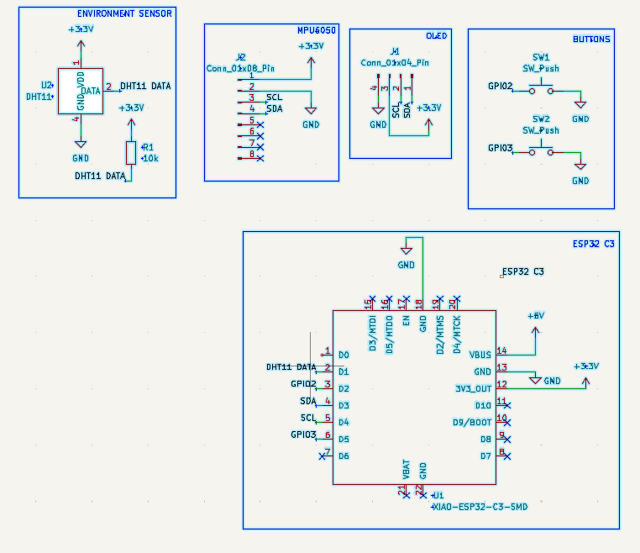
Day 1 of working on the Starbie
On the First day, I used KiCad to make the schematics, and then I made my first draft of the PCB board! I did have some issues with it, so I decided to make another PCB on day 2.
These are the schematics! →

Slide 4
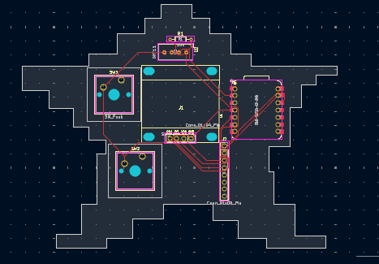
Day 2 of working on the starbie
On day 2, I redid the pcb board, and then it was onto arduino stuff. I got everything for the arduino set up, and made sure everything was functional!
Here is the PCB Board! →

Slide 5
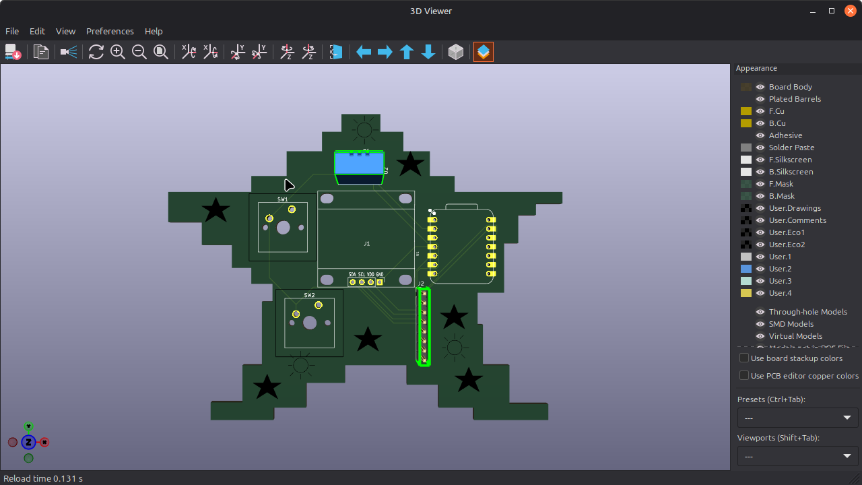
Day 3
On day 3, I decided that I’d use my time to polish off the starbie, and work on adding in some of my own details, and adding custom icons to the PCB. I unfortunately couldn’t figure out how to add icons, but I did draw some stuff on the PCB.
Here is all the stuff I drew! →

Slide 6
Thats all for this week!
Thanks for looking at what I’ve done so far, and good luck for week 2!

